Slide 1

Packet Sending Tool
Harshit Vashisth

Slide 2

AGENDA
Purpose
Objective
Project Perspective
Project Functions
GUI
Conclusion
Zero level DFD
First level DFD
Second level DFD

Slide 3
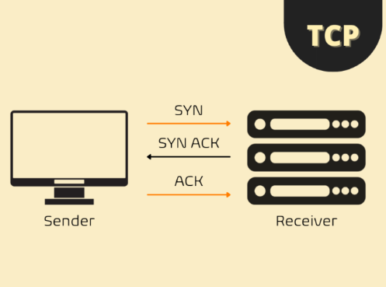
PURPOSE
In today's life, networks are playing a very important role in telecommunication. Without the network, almost all types of communication and service are useless. Hence, this makes the network concept more important for all programmers and network administrators.
To maintain and manage the security of network communication, many times network administrators or network maintainers need to find and control the traffic flowing into the network wire and also find exactly what and which types of data packets are actually flowing in the Networks. For this situation, there are many types of Network analyzing tools available on the internet. Basically, these types of tools come on the ground to help network administrators.

Slide 4
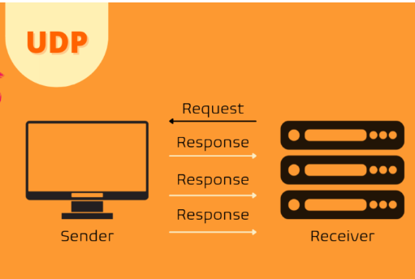
Every client interacts with the server through sending and receiving various types of data Packets like TCP, UDP, etc. so, the main objective of our program is going to do the sending and receiving of packets and then analyze and represent those packets in an easy and understandable manner and if some pattern matches with the pattern already defined receiver side will reply back to the sender side.
OBJECTIVE

Slide 5
PROJECT PERSPECTIVE
Every Client Interact With Server Through Sending and receiving various types of data Packets like TCP, UDP etc. So, our program is going to send and receive these packets and show all the necessary details in the form of a graphical user interface and then analyse some predefined patterns and reply back to the user or the senders site and represent those packets in easy and understandable manner In this Project a packet sender is made using socket programming and this tool helps in sending packets to different IP Addresses and to set speed at which I want to send in micro second .

Slide 6
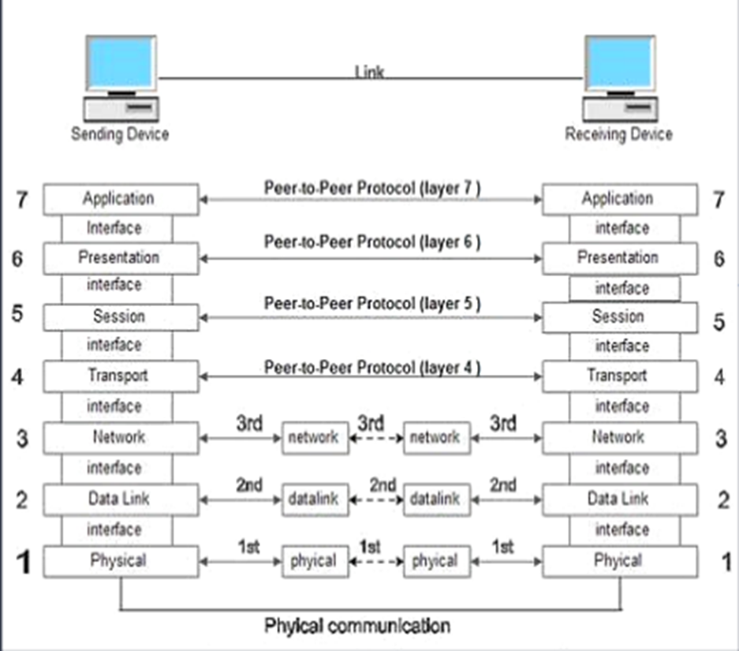
Project Function
Some typical applications of Packet Sender include:
Video calling feature can be done with the help of UDP .
Troubleshooting network devices that use network servers.
Troubleshooting network devices that use network clients.
Testing and development of new network protocols .
Automation (via Packet Sender's command-line interface or resend feature).
Stress-testing a device (using an intense network generator tool).

Slide 7
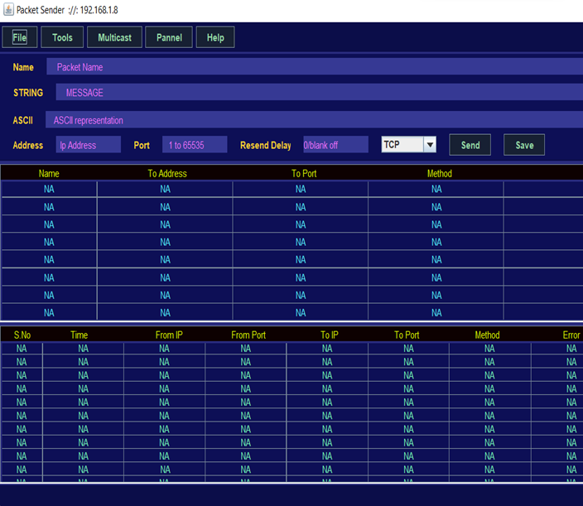
CONCLUSION
Packet Senders are special program and tool that can send packets in a network and then analyze them and display them in a particular order in a graphical user interface and is able to reply back some particular packets. The “Packet Sender Tool” has the ability to send data packets in TCP, UDP, etc. and after sending these packets, it also provides the facilities to extract these data packets and represent these packets in an easily understandable manner with the help of a graphical user interface. Basically, a Packet Sender can send all types of packets like TCP, UDP,SSL, ICMP, HTTP, FTP, etc. but till now I have only focused on UDP and TCP Packets.

Slide 8
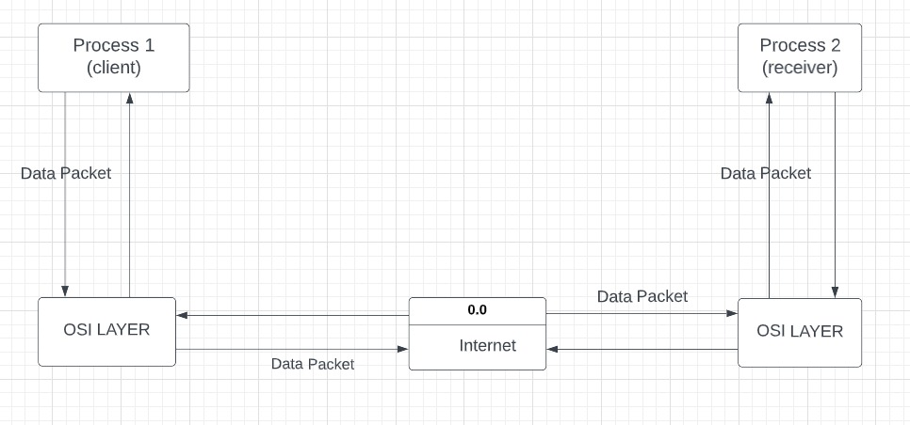
ZERO LEVEL DFD OF PACKET SENDER

Slide 9
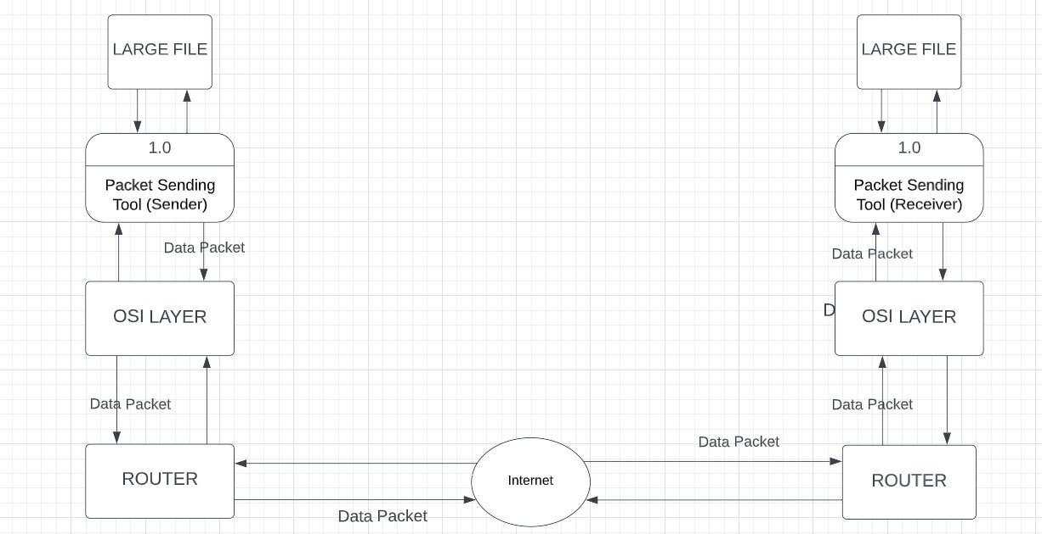
FIRST LEVEL DFD OF PACKET SENDER

Slide 10
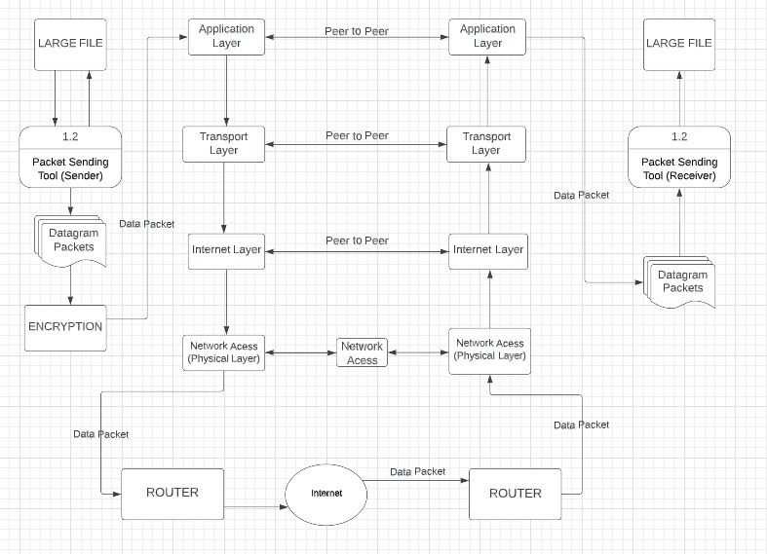
SECOND LEVEL DFD OF PACKET SENDER

Slide 11
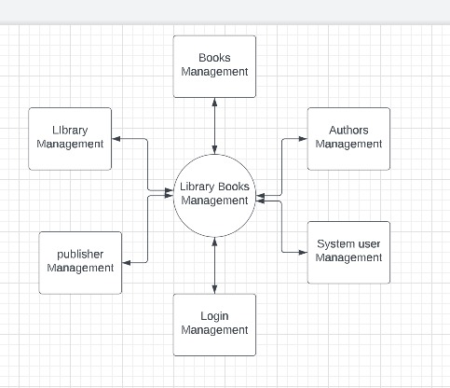
ZERO LEVEL DFD OF LIBRARY MANAGEMENT SYSTEM

Slide 12
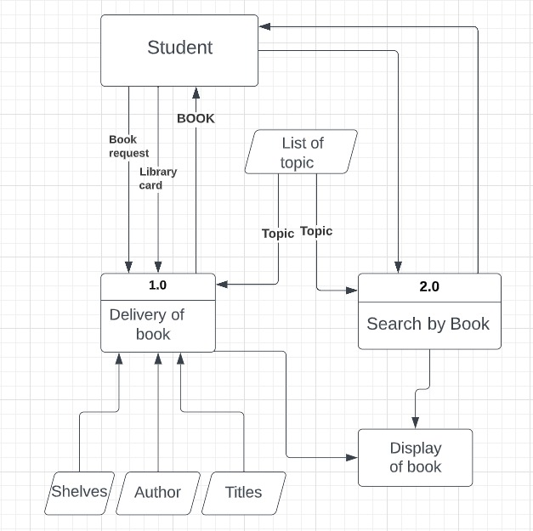
FIRST LEVEL DFD OF LIBRARY MANAGEMENT SYSTEM

Slide 13
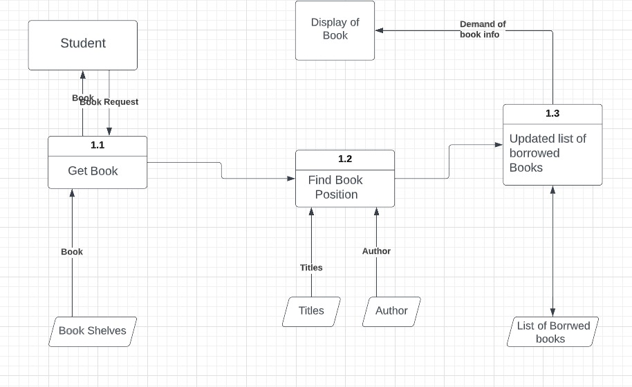
SECOND LEVEL DFD OF LIBRARY MANAGEMENT SYSTEM

Slide 14
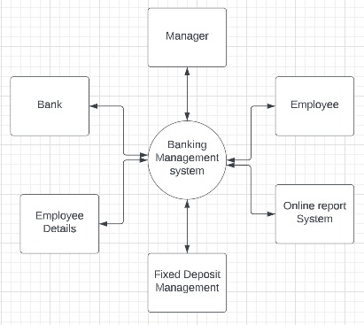
ZERO LEVEL DFD OF BANK MANAGEMENT SYSTEM

Slide 15
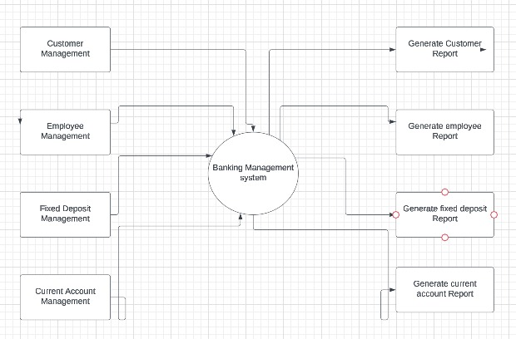
FIRST LEVEL DFD OF BANK MANAGEMENT SYSTEM

Slide 16
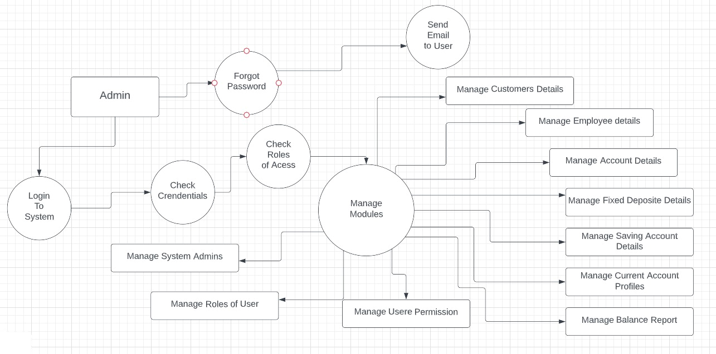
SECOND LEVEL DFD OF BANK MANAGEMENT SYSTEM

Slide 17

THANK YOU
HARSHIT VASHITH

